Slide 1
Access to SQL
With Peter Radford and Nik Rowlands

Slide 2
Computational Thinking
Computational Thinking (CT) is a problem solving method that uses computer science techniques. The term computational thinking was first used by Seymour Papert in 1996. Computational thinking can be used to algorithmically solve complicated problems of scale, and is often used to realize large improvements in efficiency. (Wikipedia ☺)

Slide 3
Computational Thinking
Analyzing and logically organizing data
Data modeling, data abstractions, and simulations
Formulating problems such that computers may assist
Identifying, testing, and implementing possible solutions
Automating solutions via algorithmic thinking
Generalizing and applying this process to other problems

Slide 4
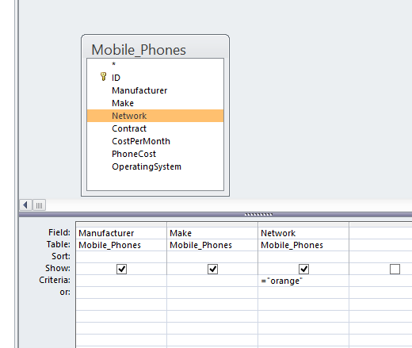
Microsoft Access
Analyzing and logically organizing data.
How many phones are on the Orange Network?

Slide 5
Computational Thinking
Data modeling, data abstractions, and simulations
Formulating problems such that computers may assist

Slide 6
Microsoft Access - SQL
SELECT count(*) AS phones_on_orange FROM Mobile_Phones WHERE (((Mobile_Phones.Network)="orange"))
GROUP BY Mobile_Phones.Network;

Slide 7
Microsoft Access - SQL
SELECT is SQL’s method of querying a database.
What do the following queries do?
SELECT * FROM Mobile_Phones;
SELECT * FROM Mobile_Phones ORDER BY Network;
SELECT * FROM Mobile_Phones WHERE ((Mobile_Phones.Contract) = “Monthly”);
SELECT Make FROM Mobile_Phones GROUP BY Make;
SELECT Manufacturer, COUNT(*) as total_phones FROM Mobile_Phones GROUP BY Manufacturer;

Slide 8
Microsoft Access - SQL
UPDATE does exactly what it says on the tin.
Syntax:
UPDATE table SET newvalue WHERE criteria;
UPDATE Mobile_Phones SET Network = ‘Vodafone’ WHERE Network = ‘Vodaphone’;
There are 3 Lumia phones which have been misspelt as Lumnia.

Slide 9
Microsoft Access - SQL
INSERT
Syntax
INSERT INTO target [(field1[, field2[, …]])] VALUES (value1[, value2[, …])
MAKE SURE THE DATASHEET VIEW IS CLOSED!
INSERT INTO Mobile_Phones (ID, Manufacturer, Make, Network, Contract, CostPerMonth, PhoneCost, OperatingSystem) VALUES (31, 'Apple', 'IPhone6', 'Orange', 'Monthly', '£49.99', '£59.99', 'IOS');

Slide 10
Computational Thinking
Identifying, testing, and implementing possible solutions
Automating solutions via algorithmic thinking
Generalizing and applying this process to other problems

